Slide 1
BIOS27816: Population biology of infectious diseases of global health concern
Pathogens with Complex Transmission Mechanisms:
Case Study in HIV
UChicago Center in Paris
Paris, France
January 2024

Slide 2
Pathogens exhibit diverse transmission mechanisms that require tailored modeling structures
μ
μ
μ
b
β
γ
S
I
R

Slide 3
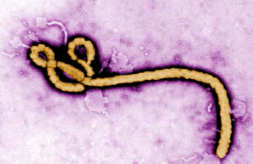
Pathogens exhibit diverse transmission mechanisms that require tailored modeling structures
Directly-transmitted diseases are transmitted via exchange of bodily fluids
Droplet (> 5 microns ) spread or direct contact
Includes sexually-transmitted pathogens, though often modeled with a more complex contact network
Smallpox (Variola spp.), HIV, Mononucleosis (Epstein Barr virus)
μ
μ
μ
b
β
γ
S
I
R

Slide 4
Pathogens exhibit diverse transmission mechanisms that require tailored modeling structures
Directly-transmitted diseases are transmitted via exchange of bodily fluids
Droplet (> 5 microns ) spread or direct contact
Includes sexually-transmitted pathogens, though often modeled with a more complex contact network
Smallpox (Variola spp.), HIV, Mononucleosis (Epstein Barr virus)
Indirectly-transmitted diseases are transmitted via droplets retained in air
Droplets < 5 microns in diameter
Measles, COVID (SARS-CoV-2)
μ
μ
μ
b
β
γ
S
I
R

Slide 5
Pathogens exhibit diverse transmission mechanisms that require tailored modeling structures
Environmentally-transmitted pathogens are transmitted outside of the host (e.g. water-borne, food-borne)
Examples: Cholera (Vibrio cholerae), Salmonellosis (Salmonella spp. bacteria), White-Nosed Syndrome (Pseudogymnoascus destructans)

Slide 6
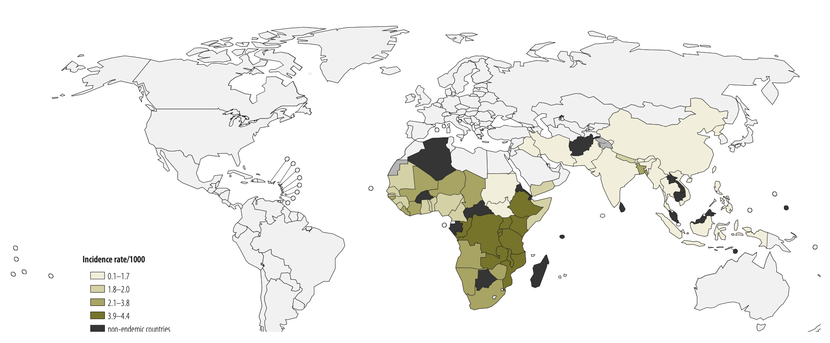
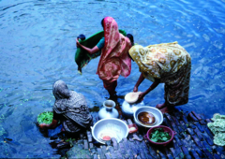
Pathogens exhibit diverse transmission mechanisms that require tailored modeling structures
Environmentally-transmitted pathogens are transmitted outside of the host (e.g. water-borne, food-borne)
Examples: Cholera (Vibrio cholerae), Salmonellosis (Salmonella spp. bacteria), White-Nosed Syndrome (Pseudogymnoascus destructans)
Global Burden of Cholera, 2012
Estimated 2.8 million cases & 95,000 deaths annually
Ali et al. 2012. WHO Bulletin.

Slide 7


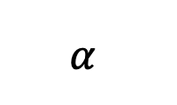
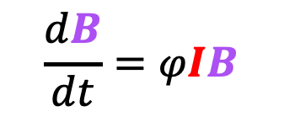

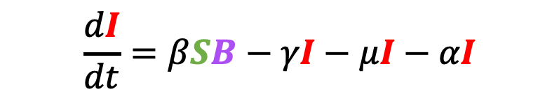
Pathogens exhibit diverse transmission mechanisms that require tailored modeling structures
Environmentally-transmitted pathogens are transmitted outside of the host (e.g. water-borne, food-borne)
Examples: Cholera (Vibrio cholerae), Salmonellosis (Salmonella spp. bacteria), White-Nosed Syndrome (Pseudogymnoascus destructans)
Here, the environmental reservoir is often modeled as its own population
μ
$$α$$
μ
μ
$$\frac{dB}{dt}=φIB$$
γ
b
β
S
I
R
$$\frac{dS}{dt}=b(S+I+R)−βSB−μS$$
$$\frac{dI}{dt}=βSB−γI−μI−αI$$
cholera environmental reservoir
$$φ$$
B
Bacteria
$$\frac{dR}{dt}=γI−μR$$
Codeço 2001. BMC Infectious Diseases.
Notes:
Kissing bugs = hemiptera = true bugs

Slide 8
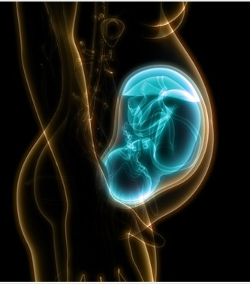
Pathogens exhibit diverse transmission mechanisms that require tailored modeling structures
Vertically-transmitted pathogens are transmitted mother-to-child in utero
Examples: HIV, Herpes simplex virus, Cytomegalovirus, Rubella, Zika

Slide 9
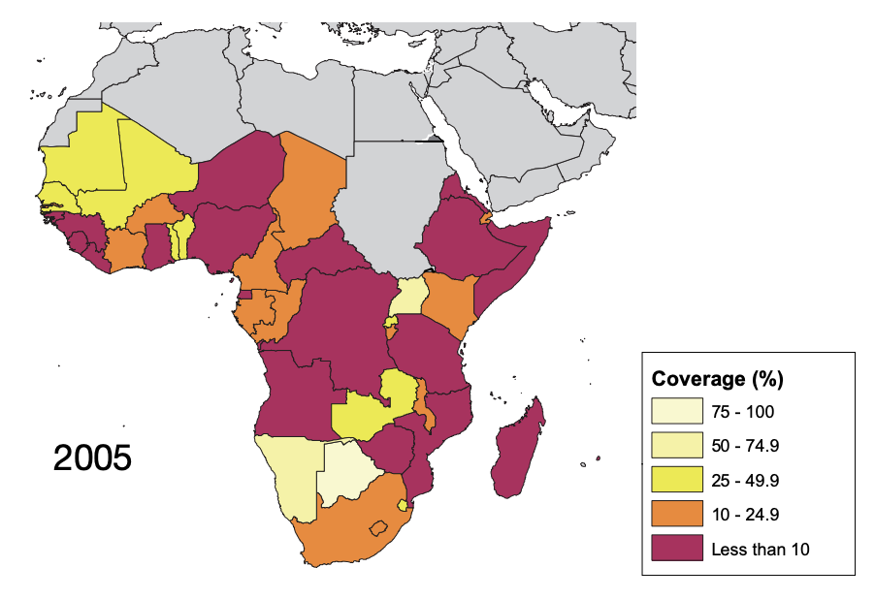
Pathogens exhibit diverse transmission mechanisms that require tailored modeling structures
Vertically-transmitted pathogens are transmitted mother-to-child in utero
Examples: HIV, Herpes simplex virus, Cytomegalovirus, Rubella, Zika
In untreated HIV+ mothers, rate of vertical transmission for HIV = 15-45%
Reduced to <1% for those on ART, though global access to ART is geographically heterogenous
ART coverage for those in need, from WHO

Slide 10
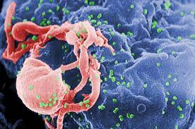

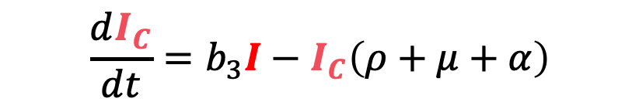






Pathogens exhibit diverse transmission mechanisms that require tailored modeling structures
Vertically-transmitted pathogens are transmitted mother-to-child in utero
Examples: HIV, Herpes simplex virus, Cytomegalovirus, Rubella, Zika
μ
I_{C}
b₃
$$α$$
$\frac{dS}{dt}=ρS_{C}−βS\left(I_{C}+I\right)$ $−μS$
$$ρ$$
$$\frac{dI}{dt}=βS\left(I_{C}+I\right)+ρI_{C}−μI−αI$$
μ
μ
$$α$$
S
β
I
$\frac{dS_{C}}{dt}=b_{1}S+b_{2}I−S_{C}$ $\left(ρ+μ\right)$
$$\frac{dI_{C}}{dt}=b_{3}I−I_{C}\left(ρ+μ+α\right)$$
$$ρ$$
b₂
S_{C}
b₁
μ
Yusuf et al. 2021. Chaos and Fractals.

Slide 11
Pathogens exhibit diverse transmission mechanisms that require tailored modeling structures
Vertically-transmitted pathogens are transmitted mother-to-child in utero
Examples: HIV, Herpes simplex virus, Cytomegalovirus, Rubella, Zika
μ
I_{C}
Vertical AND horizontal transmission!
b₃
$$α$$
$\frac{dS}{dt}=ρS_{C}−βS\left(I_{C}+I\right)$ $−μS$
$$ρ$$
$$\frac{dI}{dt}=βS\left(I_{C}+I\right)+ρI_{C}−μI−αI$$
μ
μ
$$α$$
S
β
I
$\frac{dS_{C}}{dt}=b_{1}S+b_{2}I−S_{C}$ $\left(ρ+μ\right)$
$$\frac{dI_{C}}{dt}=b_{3}I−I_{C}\left(ρ+μ+α\right)$$
$$ρ$$
b₂
S_{C}
b₁
μ
Yusuf et al. 2021. Chaos and Fractals.

Slide 12
Pathogens exhibit diverse transmission mechanisms that require tailored modeling structures
Vector-borne diseases (a type of indirect transmission) are transmitted via blood-feeding arthropod (mosquitoes, ticks, fleas)
Notes:
Kissing bugs = hemiptera = true bugs

Slide 13
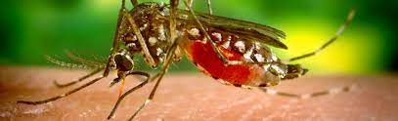
Pathogens exhibit diverse transmission mechanisms that require tailored modeling structures
Vector-borne diseases (a type of indirect transmission) are transmitted via blood-feeding arthropod (mosquitoes, ticks, fleas)
Euclidean vector: a quantity with a magnitude and direction
Epidemiological vector: an agent that carries and transmits an infectious patient into another living organism
Notes:
Kissing bugs = hemiptera = true bugs

Slide 14
Pathogens exhibit diverse transmission mechanisms that require tailored modeling structures
Vector-borne diseases (a type of indirect transmission) are transmitted via blood-feeding arthropod (mosquitoes, ticks, fleas)
Malaria: Mosquito-borne protozoan Plasmodium spp.
“Arboviruses”: Mosquito-borne viruses, including Dengue, Zika, Yellow fever virus, West Nile virus, Chikungunya virus
Sleeping sickness, also known as African trypanosomiasis: tsetse fly vector and protozoan pathogen (trypanosome)
Chagas disease: kissing bug vector and trypanosome pathogen
Plague: flea vector and bacterial pathogen (Yersinia pestis)
Notes:
Kissing bugs = hemiptera = true bugs

Slide 15
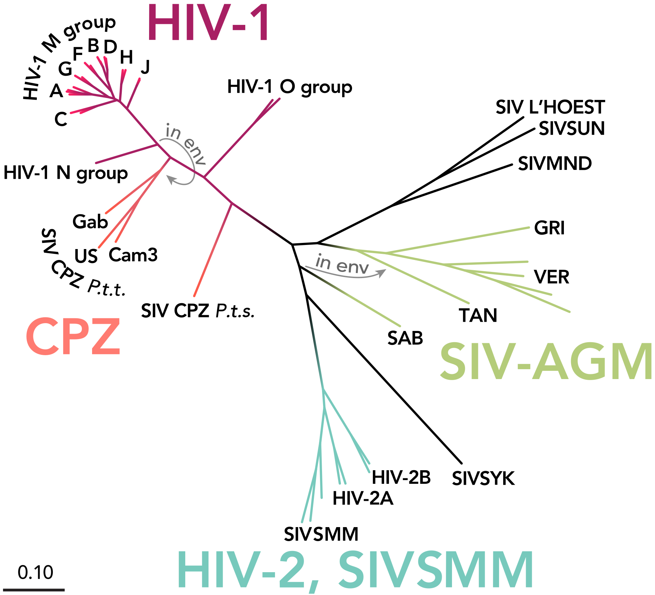
Learning about HIV
Human immunodeficiency virus = 2 species of lentivirus (a type of retrovirus) that infect humans and over time cause AIDS (acquired immunodeficiency syndrome)
HIV-1 and HIV-2 believed to have diverse zoonotic origins in Africa
Estimates of HIV spillover date ~late 19th/early 20th century.
Earliest human viral sequences from a patient in Kinshasa in 1960
(SIVgor origin; localized in Cameroon)

Slide 16
Learning about HIV
Human immunodeficiency virus = 2 species of lentivirus (a type of retrovirus) that infect humans and over time cause AIDS (acquired immunodeficiency syndrome)
HIV-1 and HIV-2 believed to have diverse zoonotic origins in Africa
Estimates of HIV spillover date ~late 19th/early 20th century.
Earliest human viral sequences from a patient in Kinshasa in 1960
(SIVgor origin; localized in Cameroon)

Slide 17
Learning about HIV
Human immunodeficiency virus = 2 species of lentivirus (a type of retrovirus) that infect humans and over time cause AIDS (acquired immunodeficiency syndrome)
HIV-1 and HIV-2 believed to have diverse zoonotic origins in Africa
Estimates of HIV spillover date ~late 19th/early 20th century.
Earliest human viral sequences from a patient in Kinshasa in 1960
(SIVgor origin; localized in Cameroon)

Slide 18
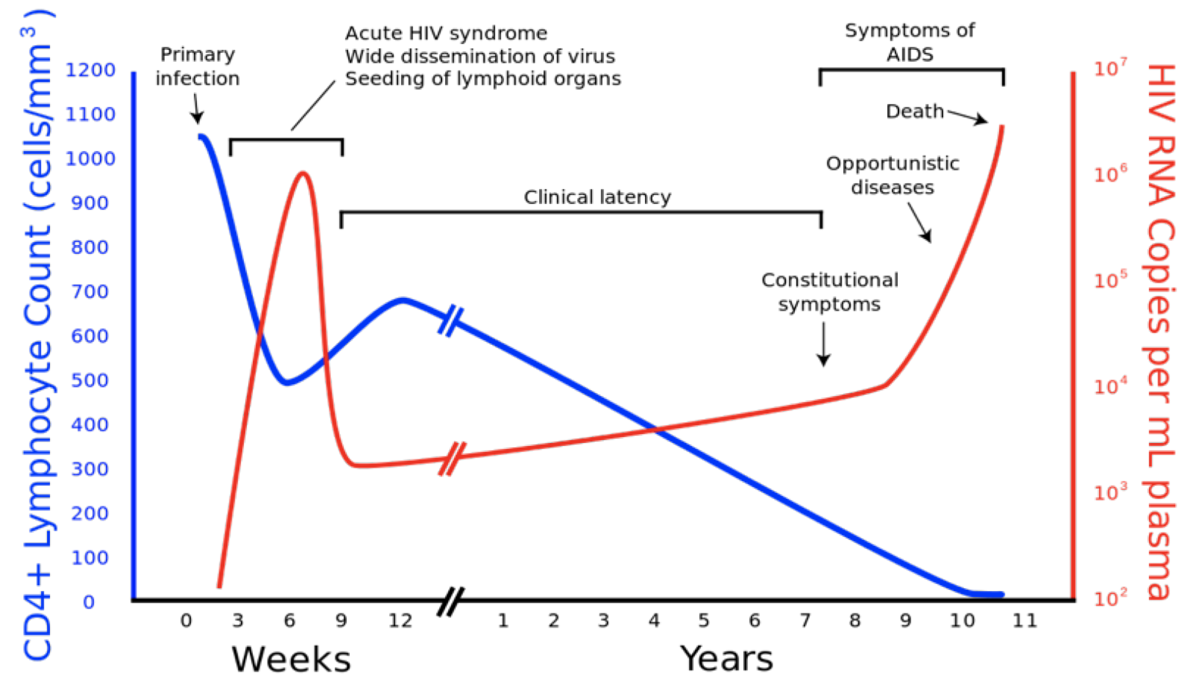
First global recognition of HIV
First recognized by newspapers in 1981 as gay men and injecting drug users in the US began reporting to hospitals with rare pneumonias and skin cancers
Widespread fear and intense stigma attributed to ‘gay cancer’
Virus co-discovered in 1983 by American Robert Gallo and Insitut Pasteur team, Françoise Barree-Sinoussi and Luc Montagnier
Early cases concentrated in gay men, injecting drug users, and hemophiliacs. Later understood that everyone was at risk
Immunocompromised patients pose risk for virus evolution.

Slide 19
First global recognition of HIV
First recognized by newspapers in 1981 as gay men and injecting drug users in the US began reporting to hospitals with rare pneumonias and skin cancers
Widespread fear and intense stigma attributed to ‘gay cancer’
Virus co-discovered in 1983 by American Robert Gallo and Insitut Pasteur team, Françoise Barree-Sinoussi and Luc Montagnier
Early cases concentrated in gay men, injecting drug users, and hemophiliacs. Later understood that everyone was at risk
Immunocompromised patients pose risk for virus evolution.
Early cases concentrated in gay men, injecting drug users, and hemophiliacs. Later understood that everyone was at risk
Immunocompromised patients pose risk for virus evolution.

Slide 20
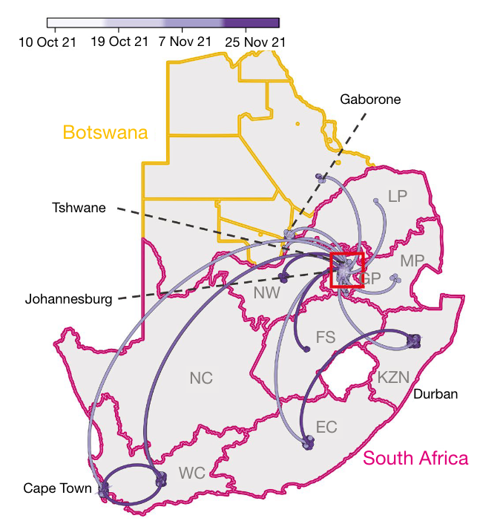
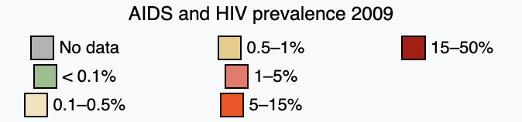
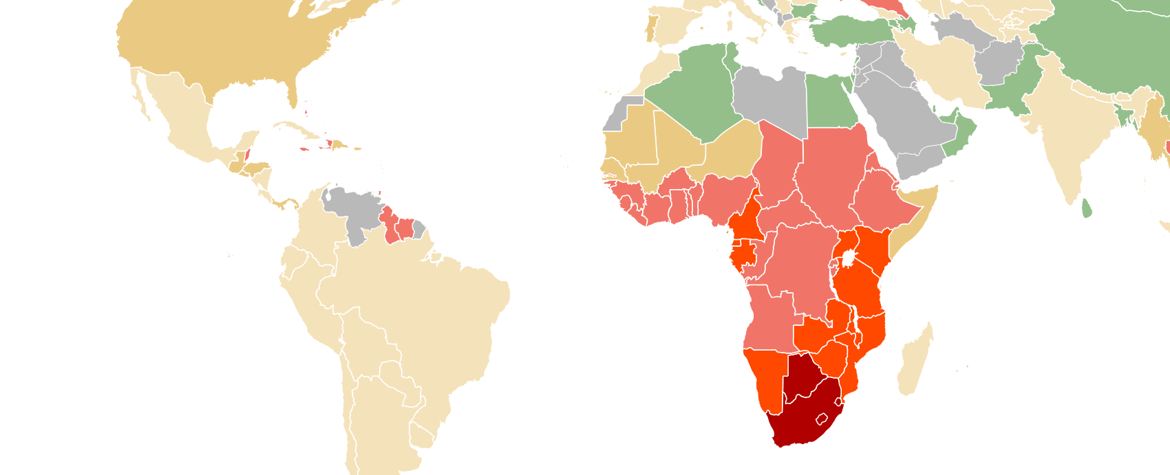
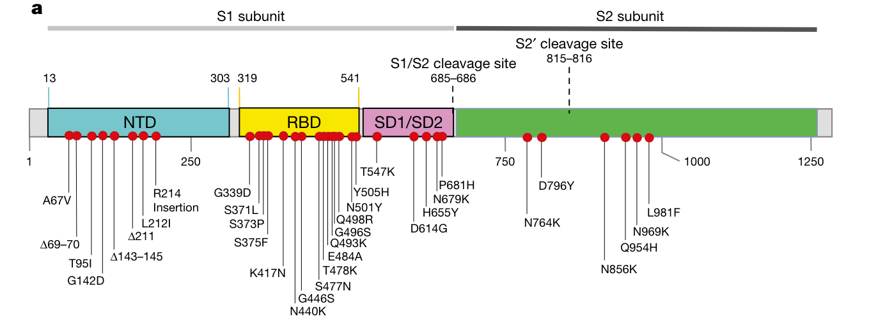
Immunocompromised patients pose risk for virus evolution.
Botswana HIV prevalence = 24.8%
South Africa HIV prevalence = 19%
Immunocompromised patients pose risk for virus evolution.
>30 spike protein mutations in emerging Omicron
Viana et al. 2022. Nature.

Slide 21
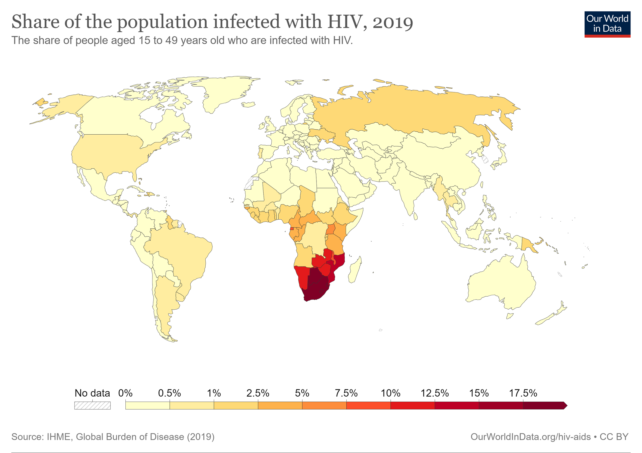
Global burden of HIV

Slide 22
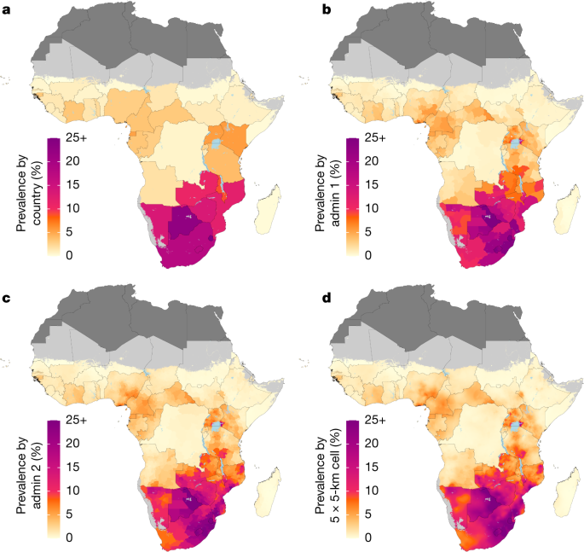
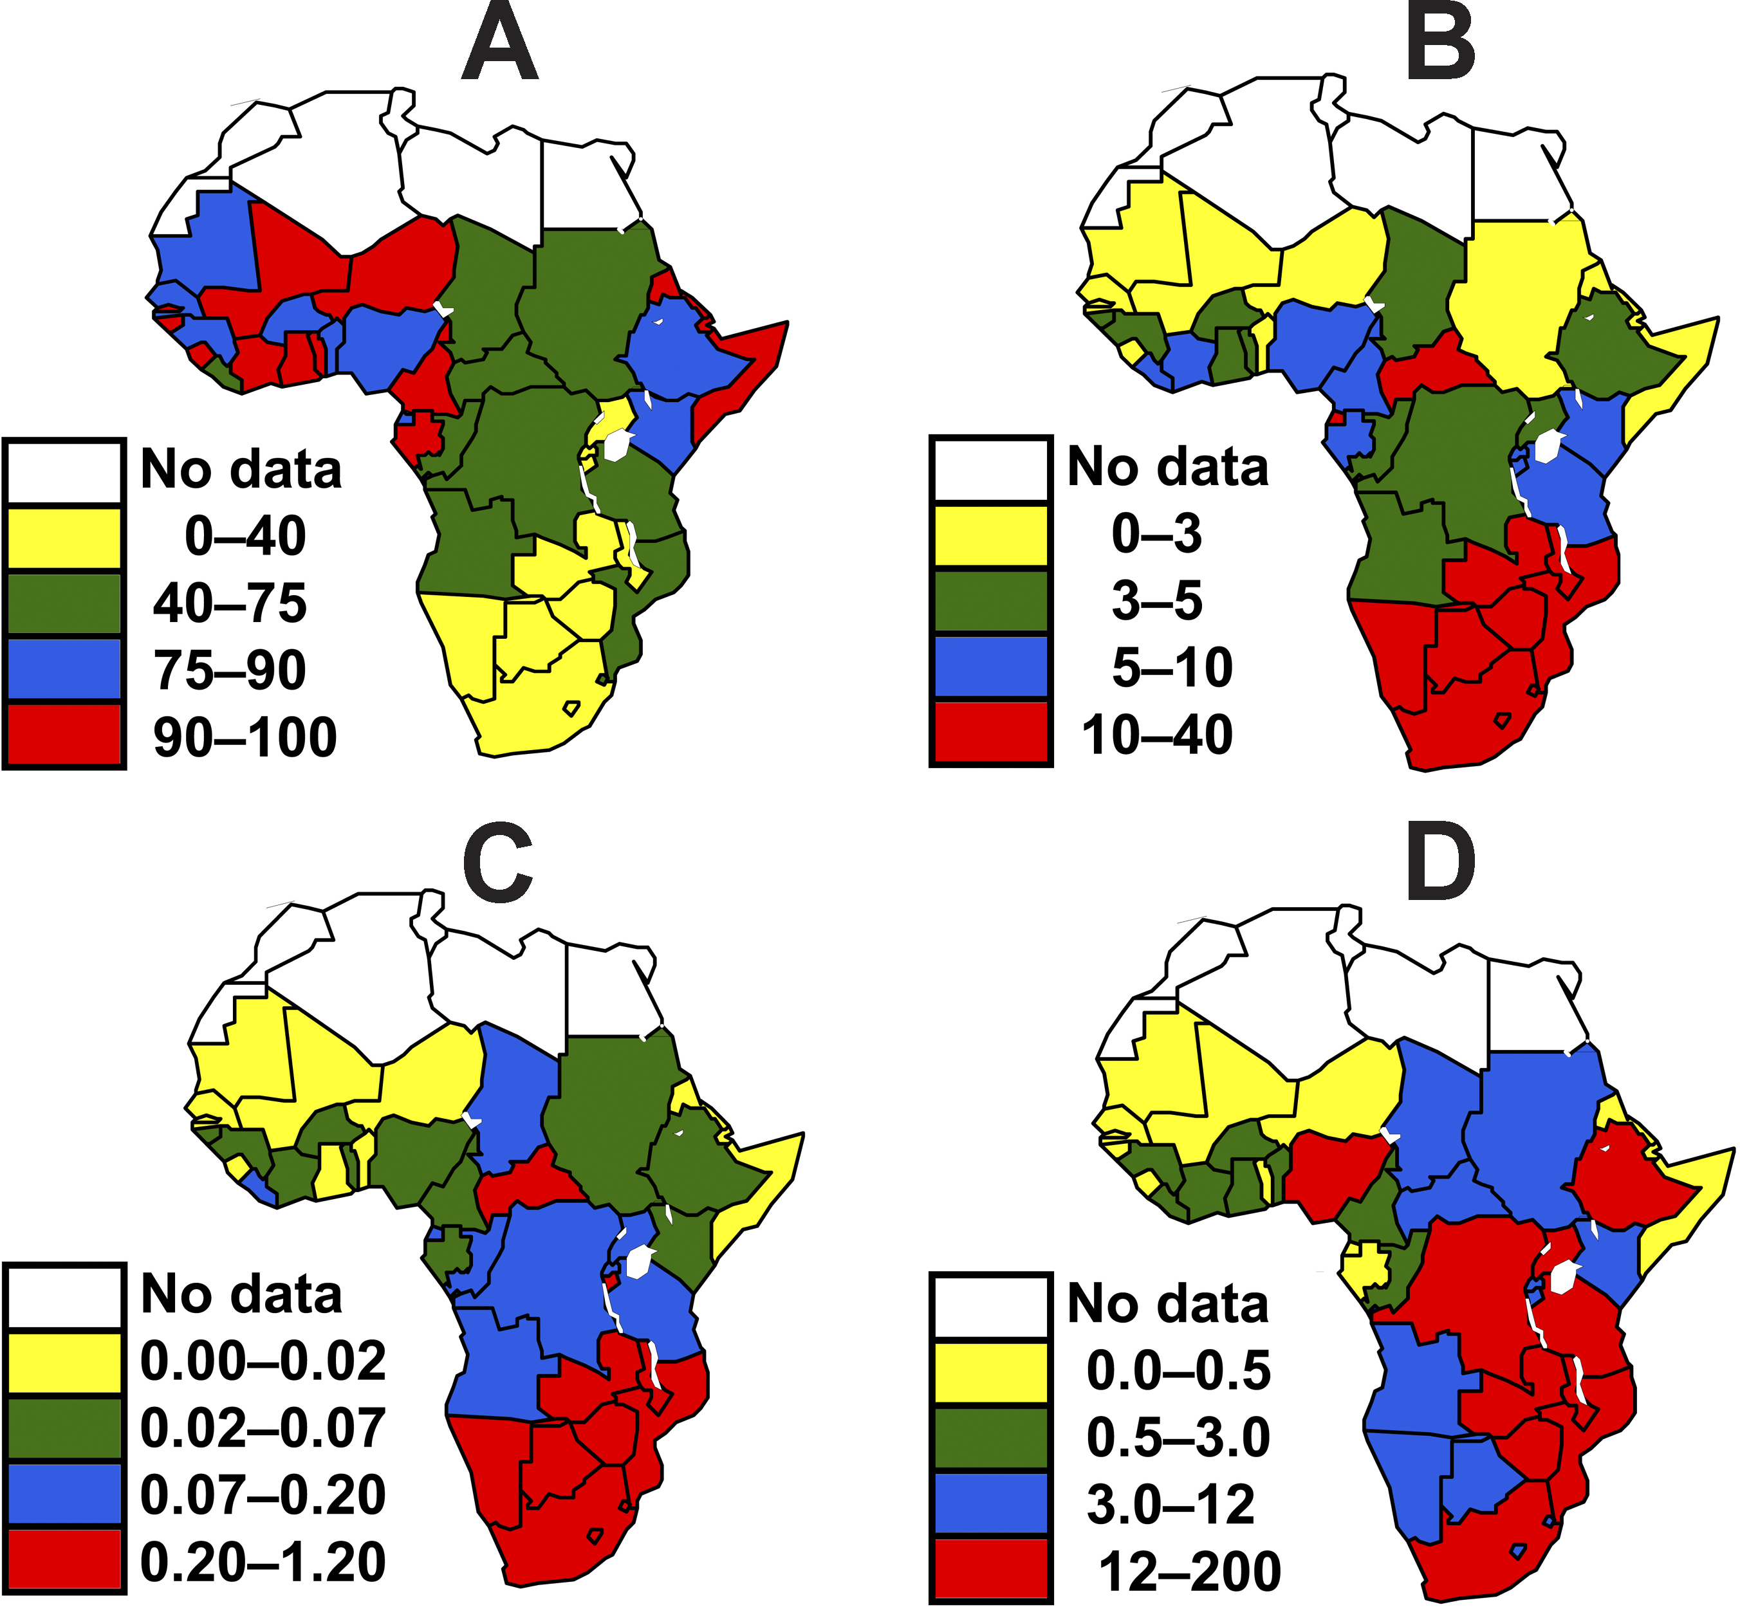
HIV epidemic in African appears to be largely driven by heterosexual transmission, often related to sex work
Proportion of Men Circumcised, 2006
Male circumcision reduces transmission of HIV from women to men in heterosexual intercourse by 60%.
Williams et al. 2006. PLoS Medicine.
Auvert et al. 2005. PLoS Medicine.
Dwyer-Lindgren et al. 2019. Nature.

Slide 23
HIV in Harare
1890-1980: modern-day Zimbabwe under British colonial rule as ‘Rhodesia’
Named after British diamond magnate Cecil Rhodes who first directed it
Same person who founded De Beers Diamond Cosortium and Rhodes scholarship
Separate governance of Northern Rhodesia (contemporary Zambia) and Southern Rhodesia (contemporary Zimbabwe) and Nyasaland (contemporary Malawi). Forced together in 1953 despite heavy African opposition.
Secession and eventual independence of Northern Rhodesia and Nyasaland
1970 white-colonialist government declared itself the independent nation of Rhodesia; violent civil war ensued until modern-day Zimbabwe was achieved independence in 1980
This was around the same time that the western world became aware of HIV
Notes:
De Beers still controls 60% of world’s diamond supply

Slide 24
HIV in Harare
1890-1980: modern-day Zimbabwe under British colonial rule as ‘Rhodesia’
Named after British diamond magnate Cecil Rhodes who first directed it
Same person who founded De Beers Diamond Cosortium and Rhodes scholarship
Separate governance of Northern Rhodesia (contemporary Zambia) and Southern Rhodesia (contemporary Zimbabwe) and Nyasaland (contemporary Malawi). Forced together in 1953 despite heavy African opposition.
Secession and eventual independence of Northern Rhodesia and Nyasaland in 1960s
1970 white-colonialist government declared itself the independent nation of Rhodesia; violent civil war ensued until modern-day Zimbabwe was achieved independence in 1980
This was around the same time that the western world became aware of HIV
Notes:
De Beers still controls 60% of world’s diamond supply

Slide 25
HIV in Harare
1890-1980: modern-day Zimbabwe under British colonial rule as ‘Rhodesia’
Named after British diamond magnate Cecil Rhodes who first directed it
Same person who founded De Beers Diamond Cosortium and Rhodes scholarship
Separate governance of Northern Rhodesia (contemporary Zambia) and Southern Rhodesia (contemporary Zimbabwe) and Nyasaland (contemporary Malawi). Forced together in 1953 despite heavy African opposition.
Secession and eventual independence of Northern Rhodesia and Nyasaland
1970 white-colonialist government declared itself the independent nation of Rhodesia; violent civil war ensued until modern-day Zimbabwe was achieved independence in 1980
This was around the same time that the western world became aware of HIV
Notes:
De Beers still controls 60% of world’s diamond supply

Slide 26
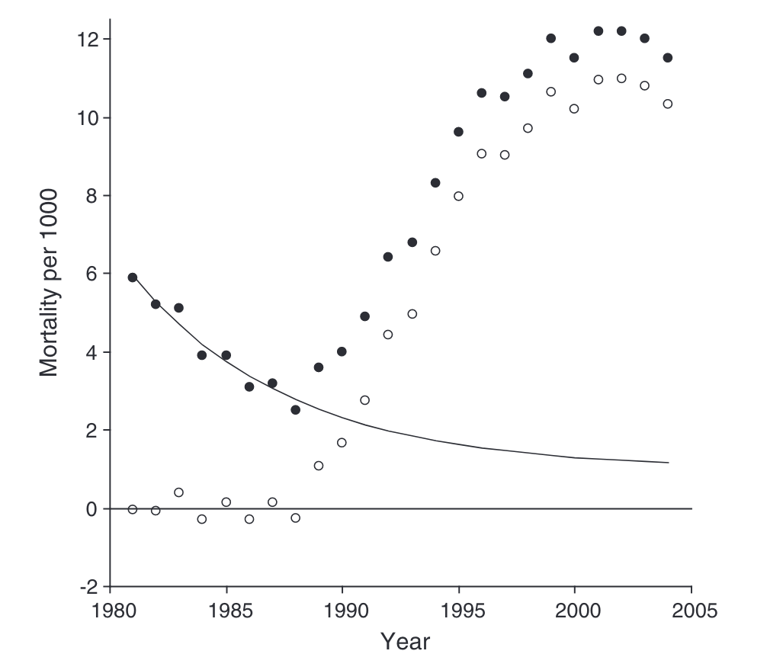
Mortality in Harare
Total mortality
Mortality attributable to AIDS
Notes:
De Beers still controls 60% of world’s diamond supply

Slide 27
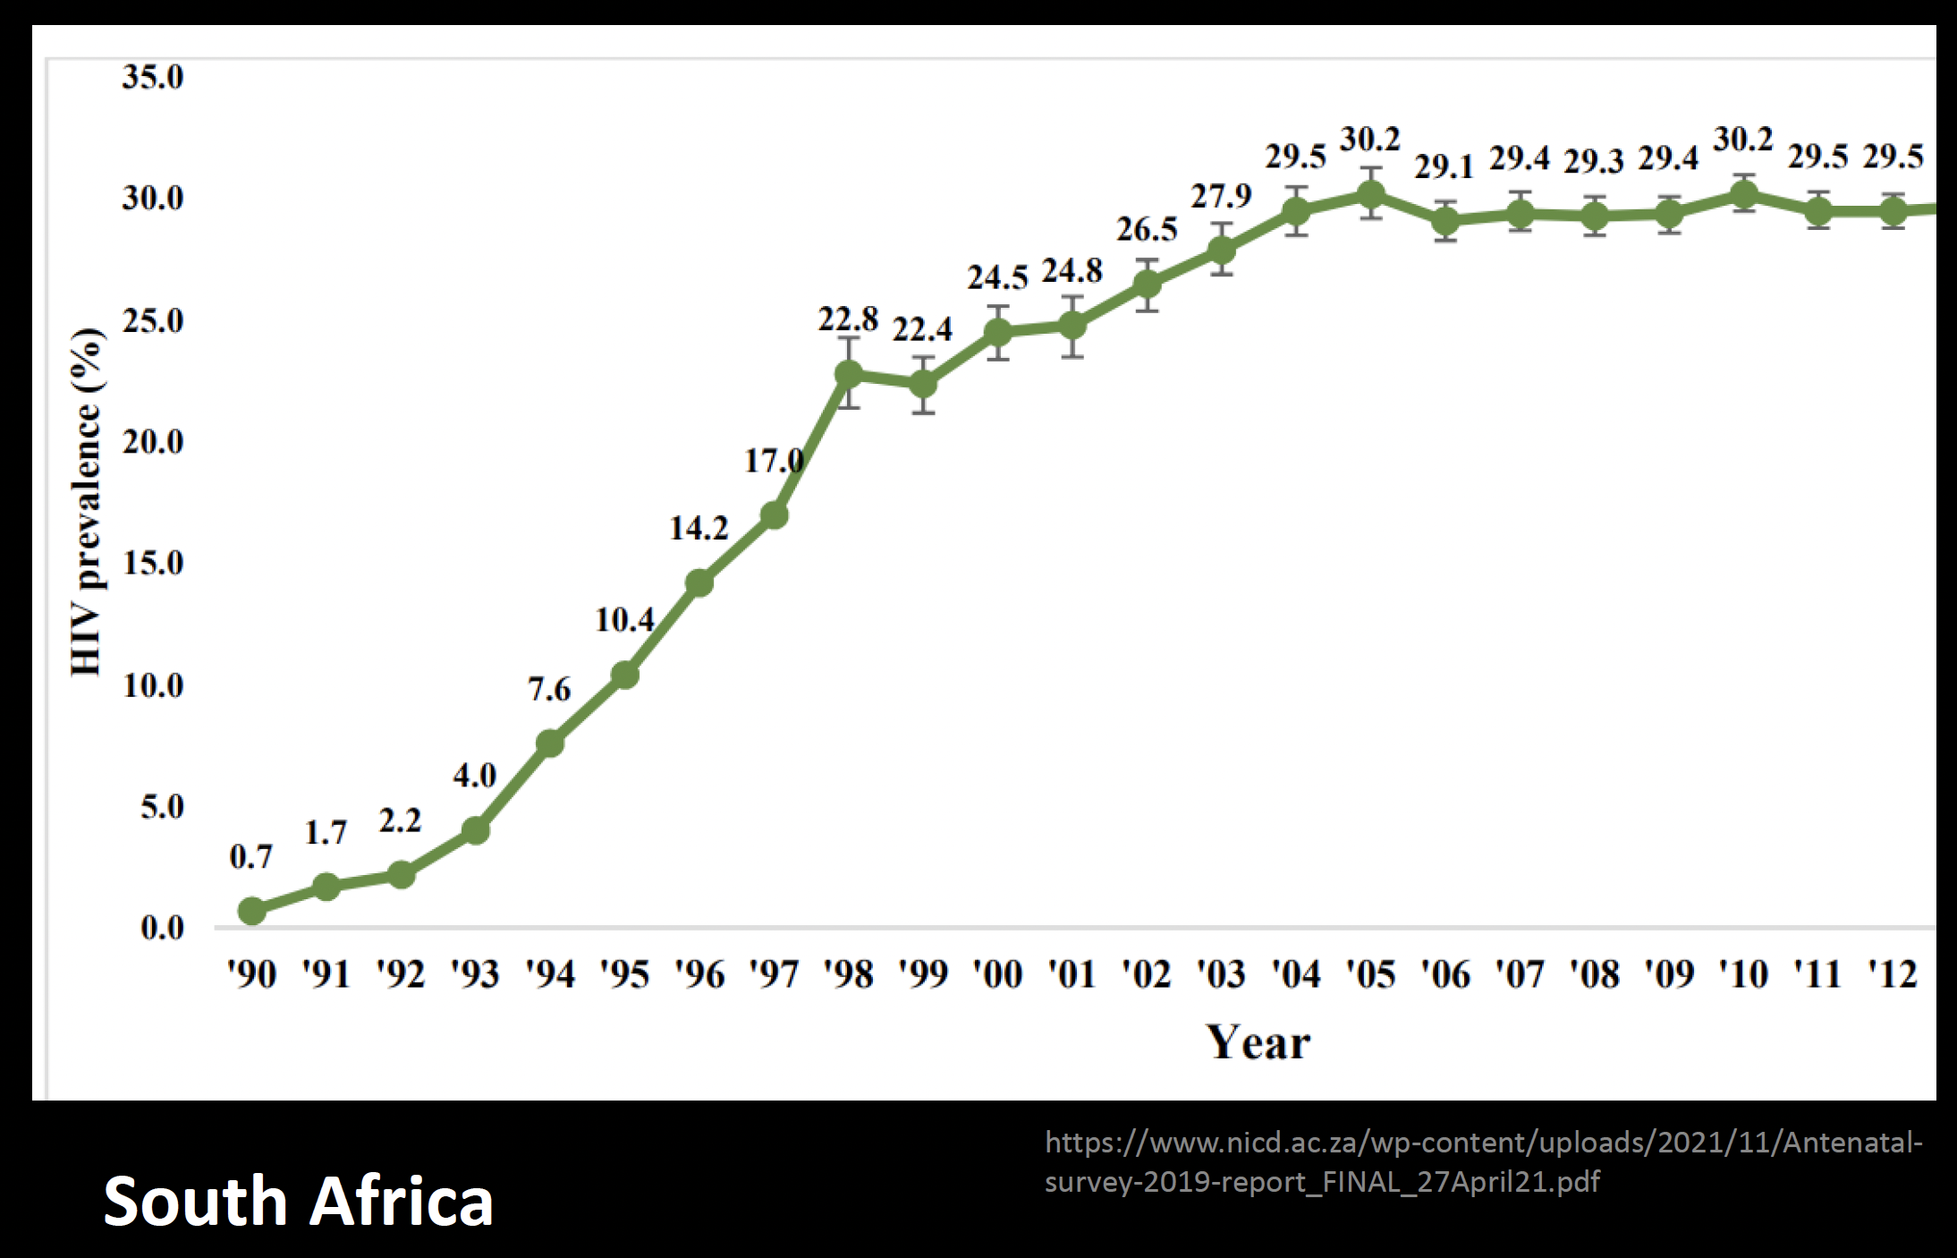
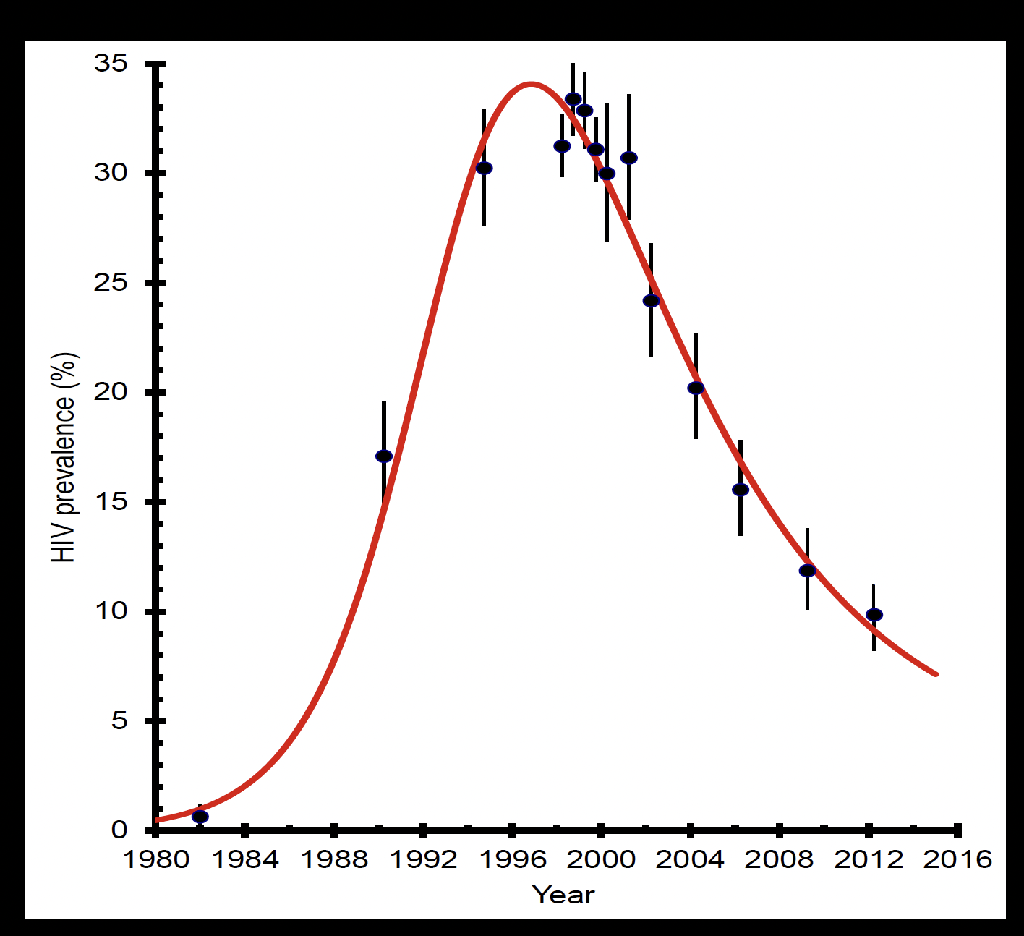
HIV in Harare
HIV in South Africa
Notes:
De Beers still controls 60% of world’s diamond supply

Slide 28
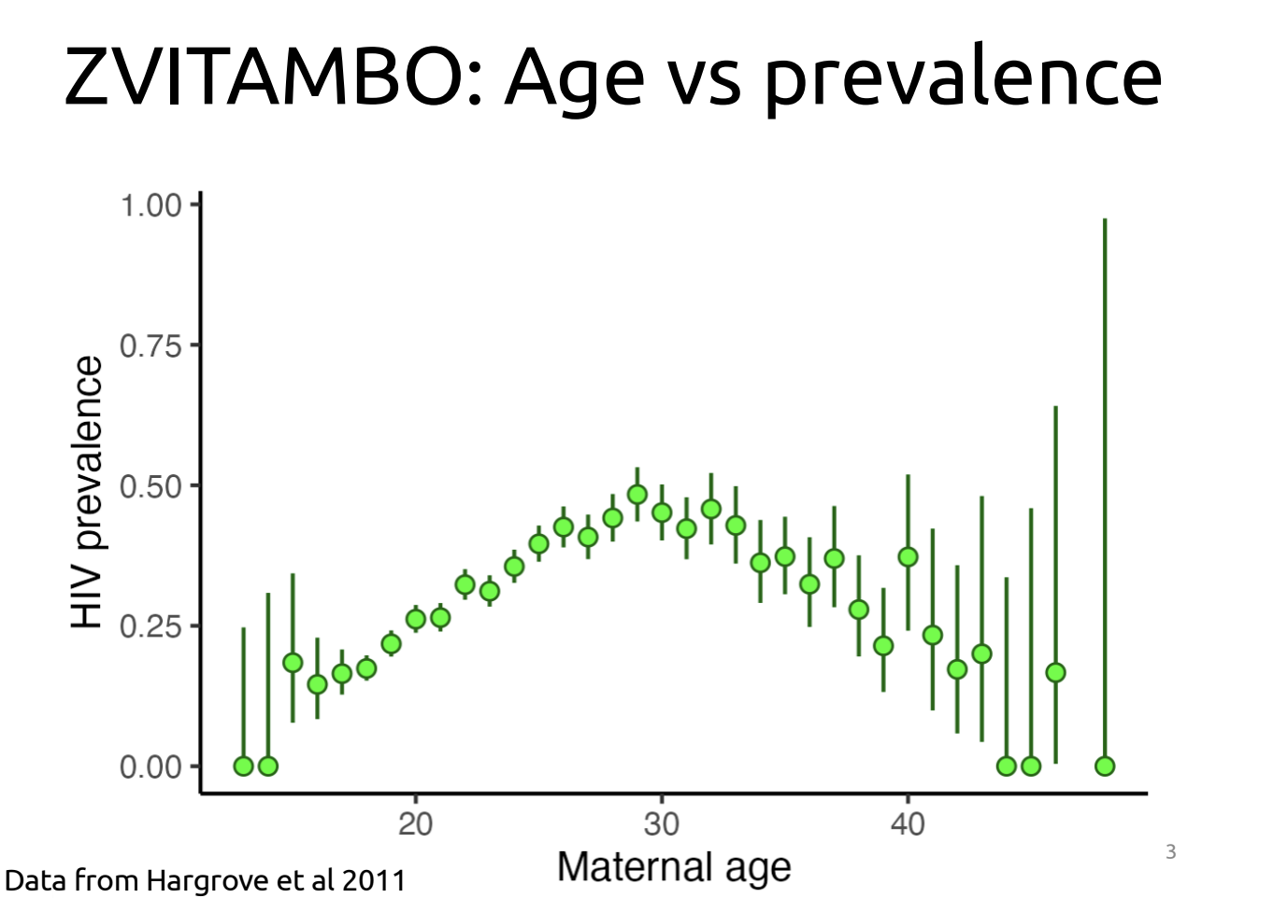
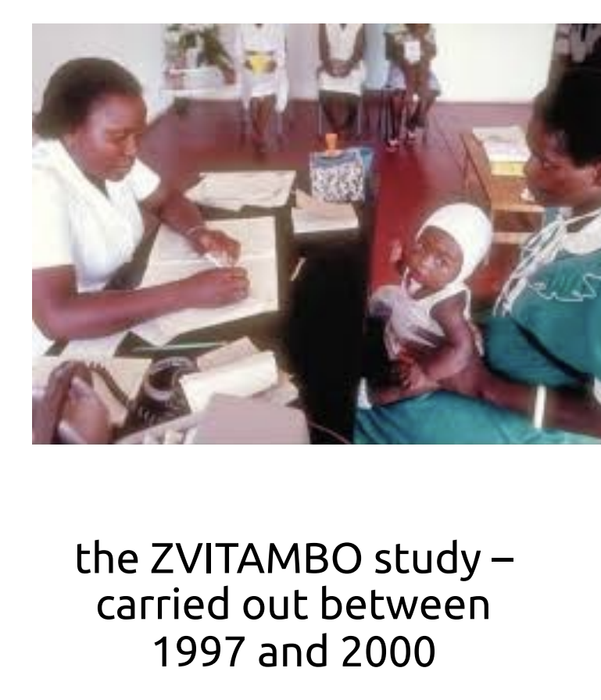
HIV in Harare

Slide 29
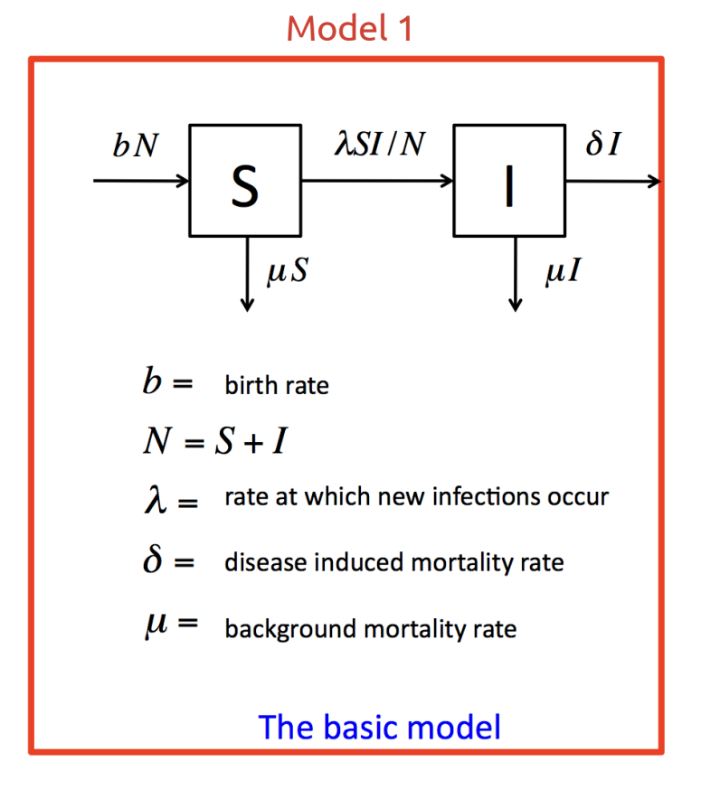
Hargrove et al. 2011 model HIV in Harare, Zimbabwe
Data from pregnant women being tested in ANC, 1980s-2000
Model fit to prevalence (proportion infected), incidence (rate of new infections), and mortality data

Slide 30
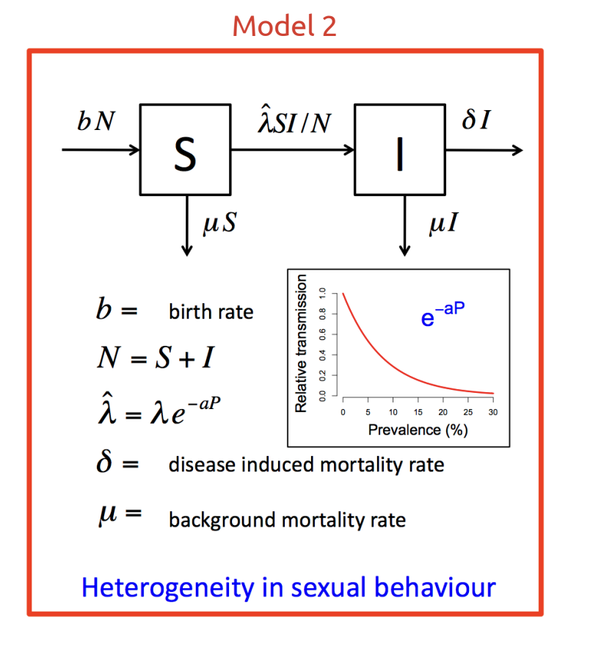
Hargrove et al. 2011 model HIV in Harare, Zimbabwe
Data from pregnant women being tested in ANC, 1980s-2000
Model fit to prevalence (proportion infected), incidence (rate of new infections), and mortality data

Slide 31
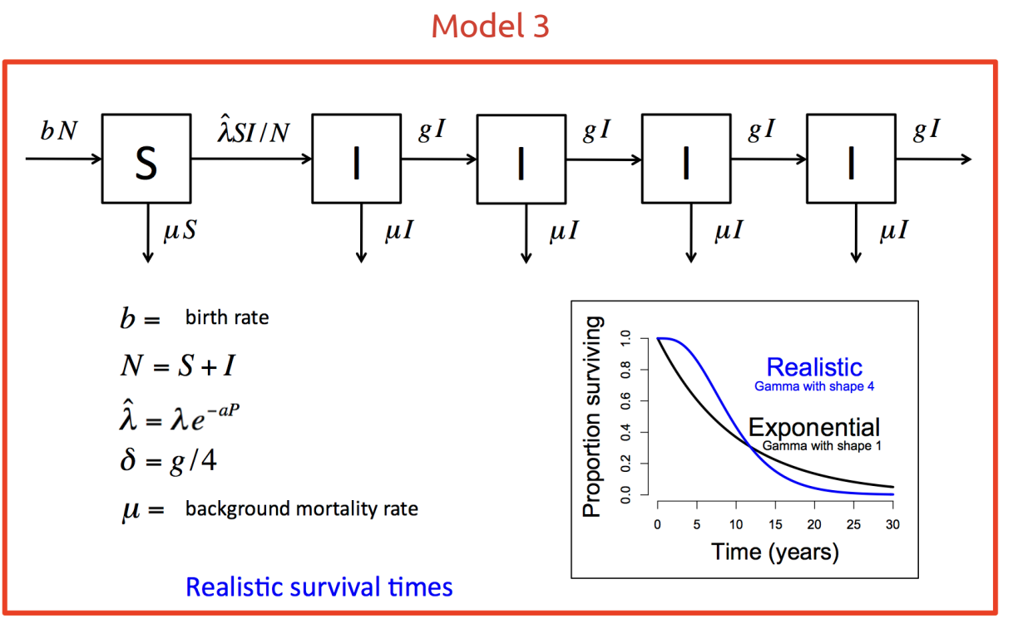
Hargrove et al. 2011 model HIV in Harare, Zimbabwe
Data from pregnant women being tested in ANC, 1980s-2000
Model fit to prevalence (proportion infected), incidence (rate of new infections), and mortality data

Slide 32
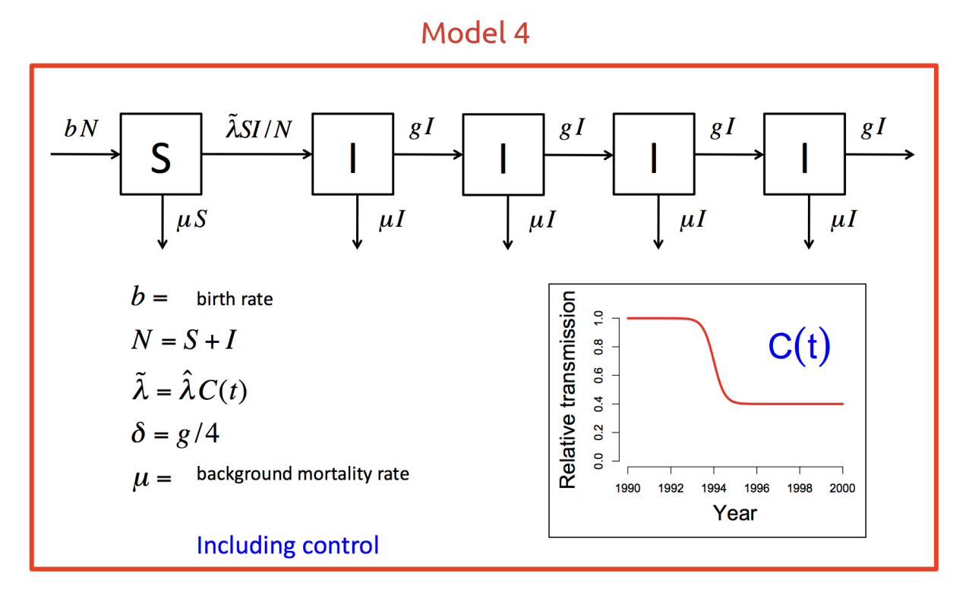
Hargrove et al. 2011 model HIV in Harare, Zimbabwe
Data from pregnant women being tested in ANC, 1980s-2000
Model fit to prevalence (proportion infected), incidence (rate of new infections), and mortality data

Slide 33
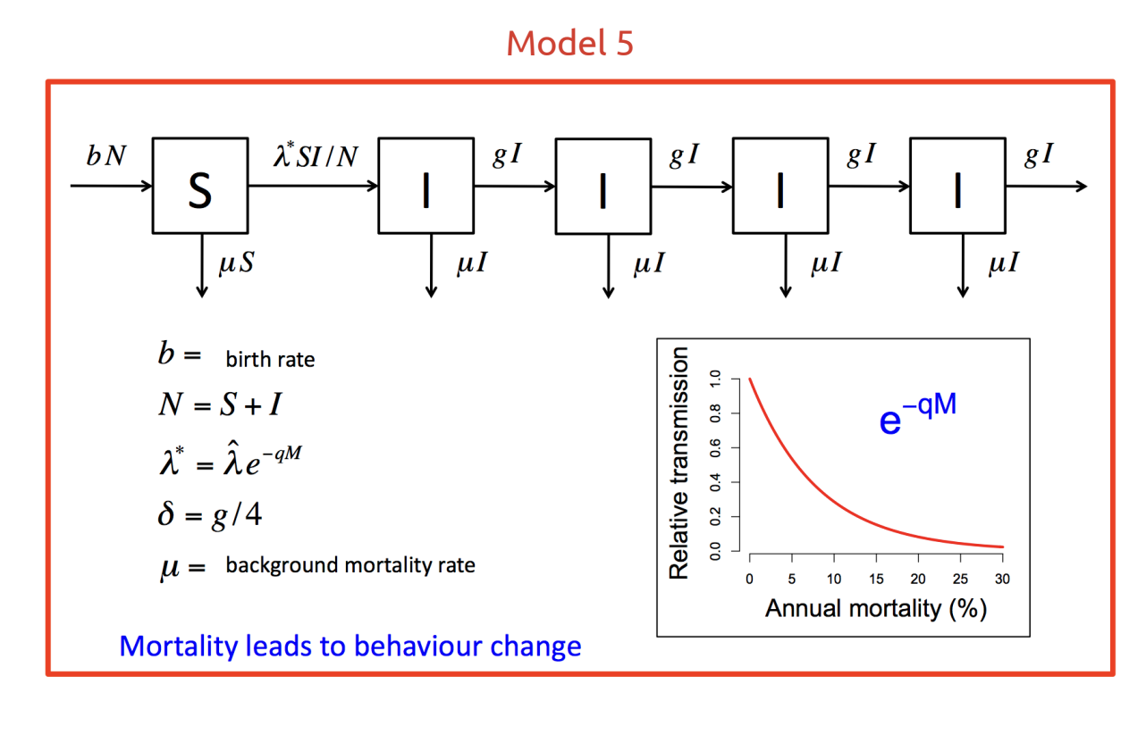
Hargrove et al. 2011 model HIV in Harare, Zimbabwe
Data from pregnant women being tested in ANC, 1980s-2000
Model fit to prevalence (proportion infected), incidence (rate of new infections), and mortality data

